Slide 1
Analytics based Daily Collection forecast model (FP Steel)
Problem Statement:
Major chunk of TSL’s sales revenue (around 70% by value) comes from Flat products.
Manual estimation leads to medium to high gaps in accuracy and huge variation over the month, compared to the daily based actual collection.
These variations cost the company in terms of idle funds or high borrowed capital cost.
Objective:
Analytics based daily collection forecast model with user friendly screen & visualizations
To reduce the variation in the gap between estimated and the actual collection
To predict cash collection on daily basis, and for month (for different modes of collection as well). By estimating the cash flow at daily, weekly and monthly level, better management of working capital is possible.
Approach:
Divide the total collection into 4 types: Cash, Credit, LC Discounting and Bank factoring
Generate calendar, holiday, dues, BPM and recency features from the input data (40+)
Use ML models to forecast different types of collection, capturing trend and seasonality
Summing predictions for all types (Prediction1); prediction on total collection (Prediction2)

Slide 2
Modes of Daily Collection
Cash
Purchase and payment for material is done instantly on same day. (generally small customers)
LC discounting
Letter of credit is a short term credit facility provided by the bank to beneficiary(Customer).
Dues from Credit sales
Credit period of 15/30/45/90 days is offered after the invoice is raised. generally large customers. (Known before hand)
Factoring through Banks
Money is raised from banks against the invoices generated. (Known daily morning at 10 am)

Slide 3
Input Data Sources Used
Customer Payment Information
Invoices contains the total invoice amount, posting date, due date , clearing date, customer name etc.
Collection data
Segment wise total collection received for past 2 years. Updated on real time basis. (Target)
Sales Plan data (BPM - Biz planning meeting)
Monthly sales plan information on quantity to be sold and rate/unit across different product lines given by M&S team.
Holiday data
RBI’s list of bank holidays for Mumbai , Delhi and Kolkata.

Slide 4
Features Generated
Calendar Features
Year, Month, Day, Quarter, Week of month, Day of Week, Month start day, Last day of month, Last week of month, last week of quarter, working day #, weekend
Holiday Features
Is holiday, Holiday Category, Pre Holiday, Post Holiday, Impact
Dues Feature
Due amount today, last and next 3,5,7,15,30 days. These are generated from invoices for credit and lc transactions.
BPM Features
Monthly level, category wise sales proportion for Auto, IPP and BPRS categories.
Recency Features
Rolling mean last 7 days, Collection same day prev month

Slide 5
Model Architecture
User Input (BPM, Factoring))
UI (Output)
SAP
BODS Job
Input Data
AIMMS
Python Forecast Model
(Server 27)
GCP
ZFBL5N
YF66
Python Script
Storing Predictions
Collection Forecast DB
Fetching Predictions

Slide 6
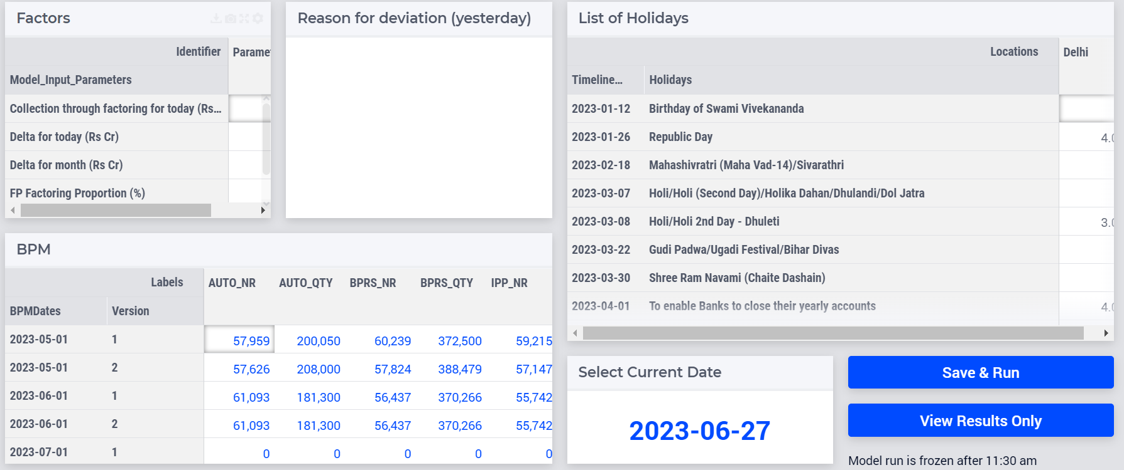
User Screen Design - Input
Daily based
User Inputs
Yearly inputs
on Holiday list
BPM Monthly
plan; Tentative +
Firm OSP
User
Execution panel

Slide 7
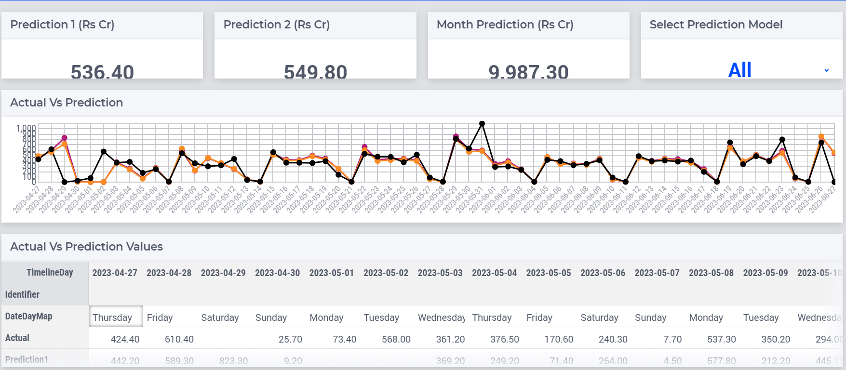
User Screen Design - Output
Predictions
Line Chart
Comparison with
Actual Collection

Slide 8
Models
Cash
Heuristics
LC Discounting
Random Forest
Prediction 1
Credit
RF + ET
Bank Factoring
Manual Input
ET
Prediction 2

Slide 9
Model Pipeline Structure
Model Pipeline uses 12 Python files.
All 11 of the necessary Python files for modelling are imported using a single Python driver function, which then outputs the results.
DataFetch_GCP.py - Updating ZFBL5N and YF66 (Input Source)
DataProcess.py - Read ZFBL5N and YF66 Feather Files and Process the data.
BPM_Process.py - Processing BPM where user gives the input
Calendar_Process.py - Process the calendar features
Cash_Pred.py - Get the Cash Predictions
Credit_Pred.py - Get the Credit Predictions(Using pycaret.regression)
LC_Pred.py - Get the LC Predictions
AllFeatModel.py - Get all Predictions for combined model
WeeklyMonthly_Pred.py - Get Weekly Predictions
Process_Output.py - Consolidating all the models Predictions
DB_Insert.py - Predictions are inserted to GCP DB table.

Slide 10
UI Pipeline Structure
AIIMS Software is used for generating the output screen.
4 Python files being used to show results in UI Screen.
AIMS_Process_Output: It will fetch the actual/predictions from dB and display in UI Screen.
Bootupdata: It will show the BPM, Holiday Data
BPM_Autofill: User to insert BPM Data
Manual Input: Used to enter Delta Amount, Factoring Amount, Delta today, Factoring Proportion by User

Slide 11
Issue related to Model Run
If the user reports that the model has not run, we need to check if the predictions have been inserted.
Missing YF66 data in Big query - Mail Sushmita Bagree to resolve the issue
Prediction not visible in UI - Check if the model has run today and find out why the model did not run. (usually the reason is missing YF66 data).
Refer to the Files for Necessary changes Debug_Utils.py DataFetch_GCP.py
UI not opening properly - check if they have the access to UI, Open the UI in your Local using AIMMS and see if it is working properly. Point out the Error, resolve it and Host the UI in AIMMS Pro and share the new link with the users.
Report to Supervisor if any recent Data is Missing.

